Slide 1
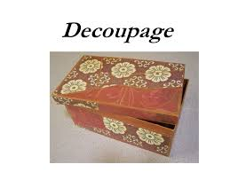
Beckwiths Art Challenge
Victorian Decoupage

Slide 2
Find our all about decoupage and create your own piece of art using the technique. This may be a little box, or notebook cover

